Slide 1


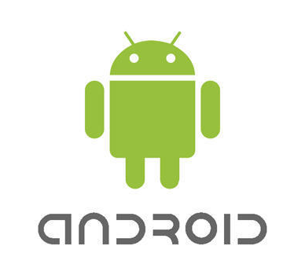
MOVIE-DB APP
Developed by –Shashank Tewari
Connect with me-
https://github.com/shanky199912
https://www.linkedin.com/in/shashank-tewari-69710116b/

Slide 2

ABOUT ORGANIZATION
Coding is the most in-demand skill of the twenty first century. Coding Blocks was started as a learning centre where they teach fundamentals of programming to college students. The courses here are designed to help students with their curriculum and give them a real feel of the IT industry. Coding Blocks was founded in 2014 by Manmohan Gupta (programmer, mathematician and a learner) with a mission to create skilled software engineers for our country and the world. Coding Blocks aim to bridge the gap between the quality of skills demanded by industry and the quality of skills imparted by conventional institutes.

Slide 3

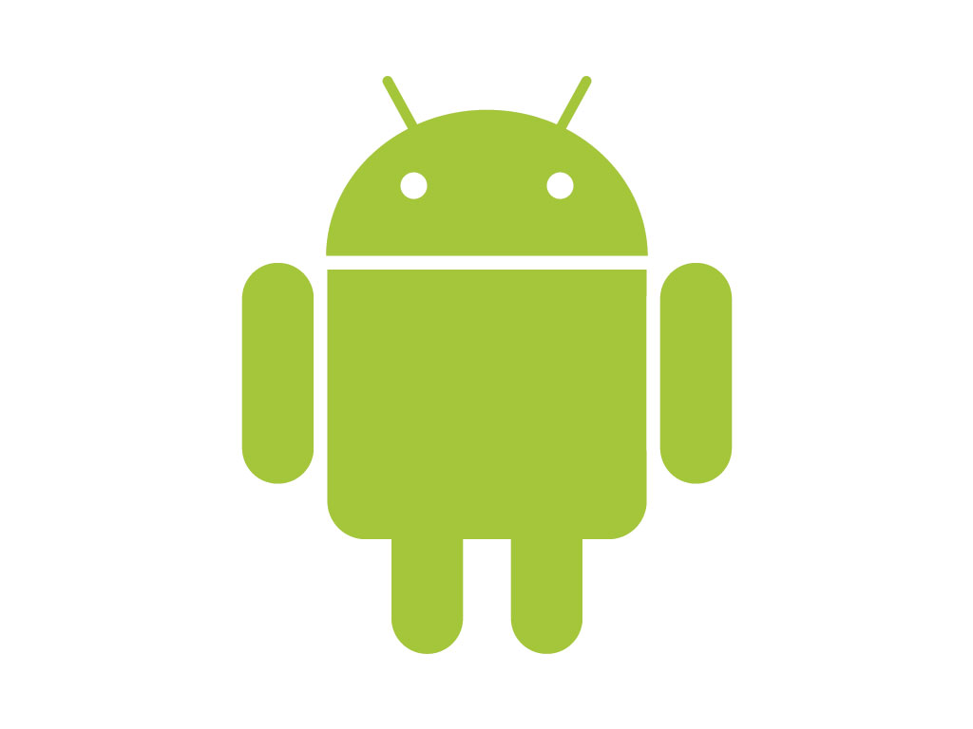
Android Development using Kotlin
There are close to 2 billion Android powered devices as of 2016, and for more than 200 million Indians Android is the primary platform for consumption of content. From social and communication apps like WhatsApp, Instagram and Snapchat to utilities like Uber, Swiggy and Paytm, Android enables companies to cater to their users 24x7.

Slide 4
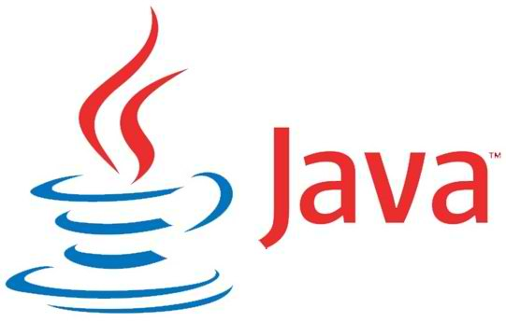
JAVA
Java is a general-purpose programming language that is class-based, object-oriented (although not a pure object-oriented language, as it contains primitive types]), and designed to have as few implementation dependencies as possible.
It is intended to let application developers write once, run anywhere (WORA) meaning that compiled Java code can run on all platforms that support Java without the need for recompilation.
Java applications are typically compiled to bytecode that can run on any Java virtual machine (JVM) regardless of the underlying computer architecture. The syntax of Java is similar to C and C++, but it has fewer low-level facilities than either of them.
As of 2019, Java was one of the most popular programming languages in use according to GitHub, particularly for client-server web applications, with a reported 9 million developers.

Slide 5

KOTLIN
Kotlin is a cross-platform, statically typed, general-purpose programming language with type inference.
Kotlin is designed to interoperate fully with Java, and the JVM version of its standard library depends on the Java Class Library, but type inference allows its syntax to be more concise.
Kotlin mainly targets the JVM, but also compiles to JavaScript or native code (via LLVM). Kotlin is sponsored by JetBrains and Google through the Kotlin Foundation.
Kotlin is officially supported by Google for mobile development on Android. Since the release of Android Studio 3.0 in October 2017, Kotlin is included as an alternative to the standard Java compiler.
The Android Kotlin compiler lets the user choose between targeting Java 6 or Java 8 compatible bytecode.
Kotlin has been Google’s preferred language for Android app development since 7 May 2019.

Slide 6
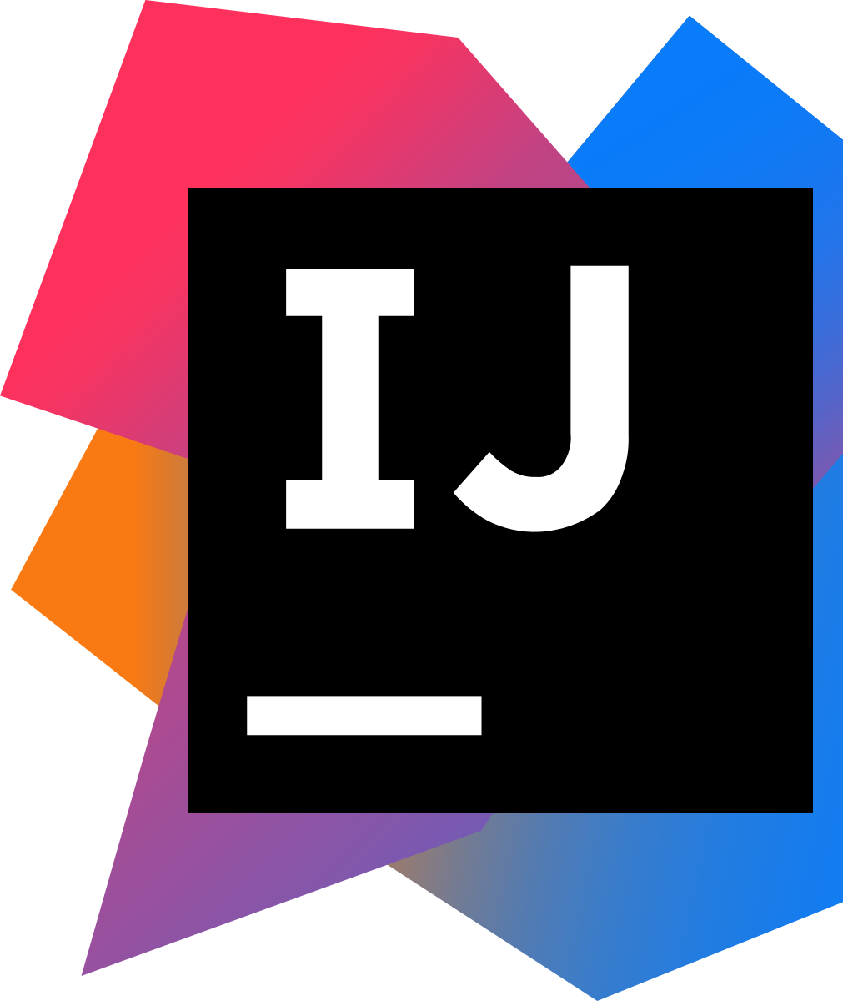
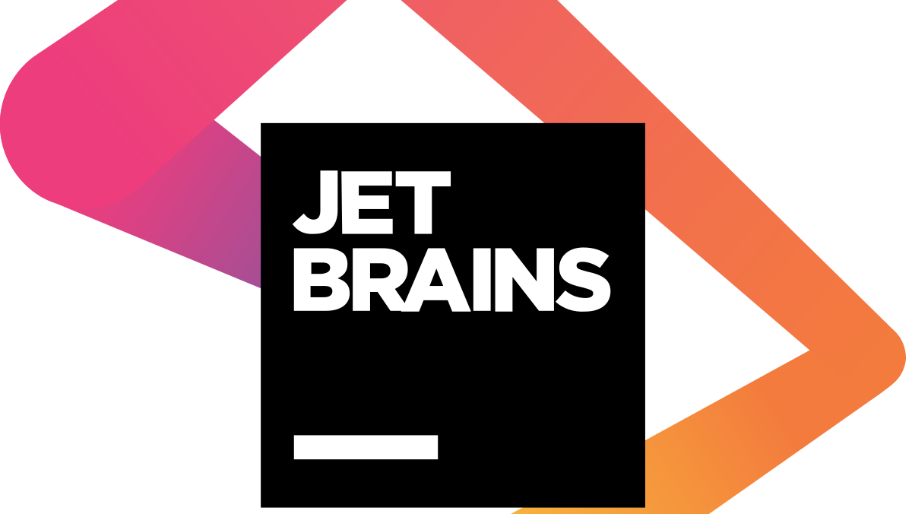
INTELLIJ IDEA
IntelliJ IDEA is a Java integrated development environment (IDE) for developing computer software.
It is developed by JetBrains (formerly known as IntelliJ), and is available as an Apache 2 Licensed community edition, and in a proprietary commercial edition.
The first version of IntelliJ IDEA was released in January 2001, and was one of the first available Java IDEs with advanced code navigation and code refactoring capabilities integrated
In a 2010 InfoWorld report, IntelliJ received the highest test centre score out of the four top Java programming tools: Eclipse, IntelliJ IDEA, NetBeans and JDeveloper.

Slide 7
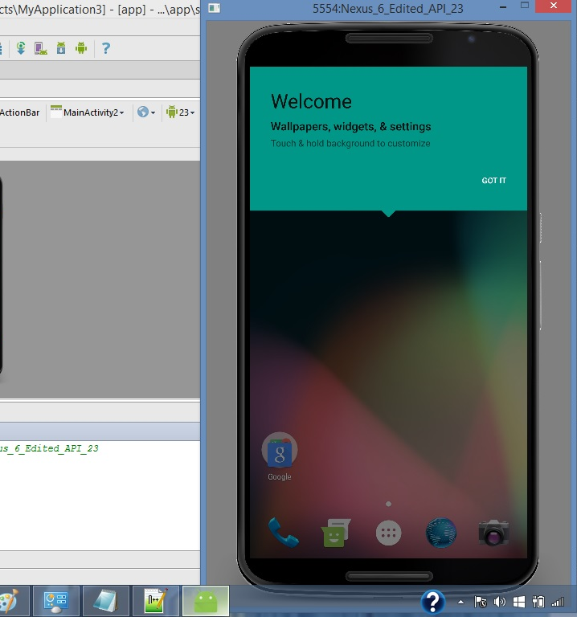
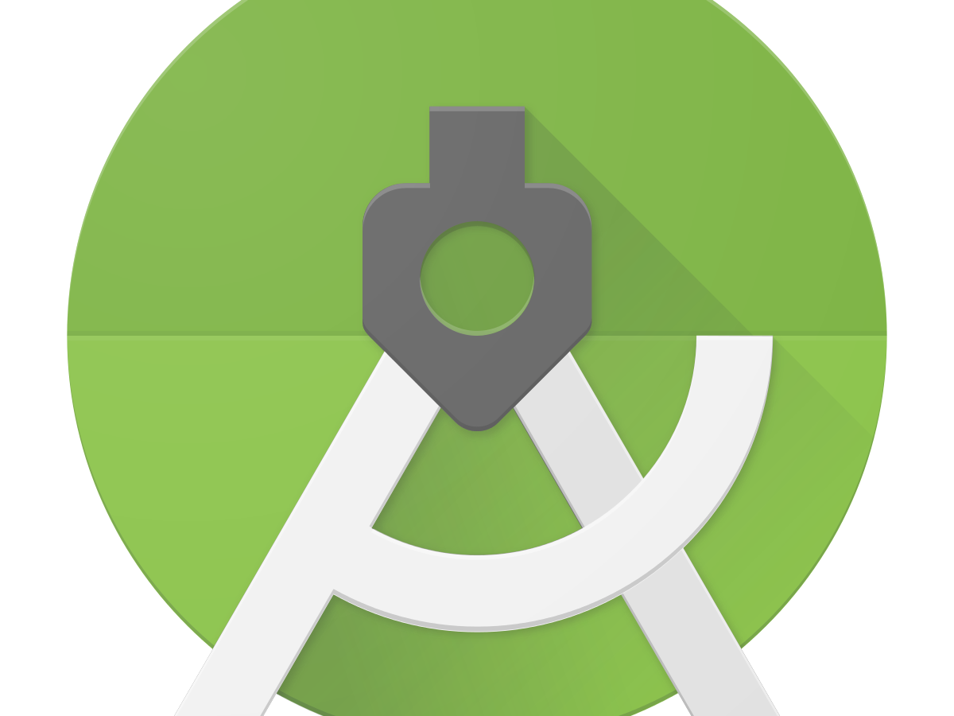
ANDROID STUDIO

Slide 8
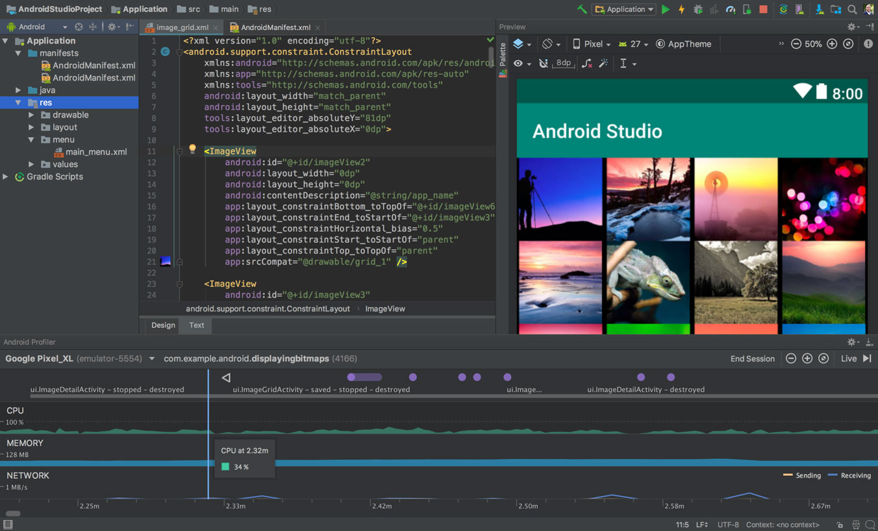
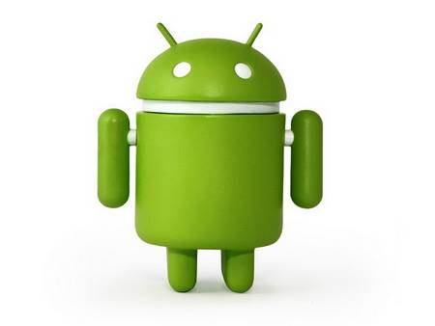
Android Studio is the official Integrated Development Environment (IDE) for Android app development, based on IntelliJ IDEA . On top of IntelliJ's powerful code editor and developer tools, Android Studio offers even more features that enhance your productivity when building Android apps, such as:
A flexible Gradle-based build system
A fast and feature-rich emulator
A unified environment where you can develop for all Android devices
Apply Changes to push code and resource changes to your running app without restarting your app
Code templates and GitHub integration to help you build common app features and import sample code
Extensive testing tools and frameworks
Lint tools to catch performance, usability, version compatibility, and other problems
C++ and NDK support
Built-in support for Google Cloud Platform, making it easy to integrate Google Cloud Messaging and App Engine

Slide 9
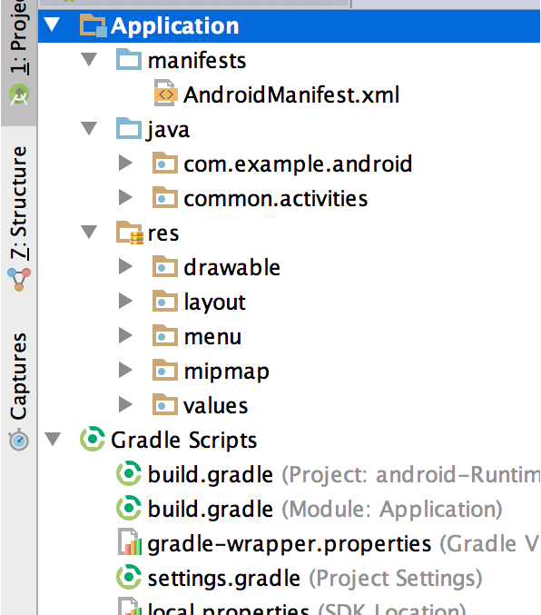
Project Structure
Each project in Android Studio contains one or more modules with source code files and resource files. Types of modules include:
Android app modules
Library modules
Google App Engine modules
All the build files are visible at the top level under Gradle Scripts and each app module contains the following folders:
manifests: Contains the AndroidManifest.xml file.
java: Contains the Java source code files, including JUnit test code.
res: Contains all non-code resources, such as XML layouts, UI strings, and bitmap images.

Slide 10
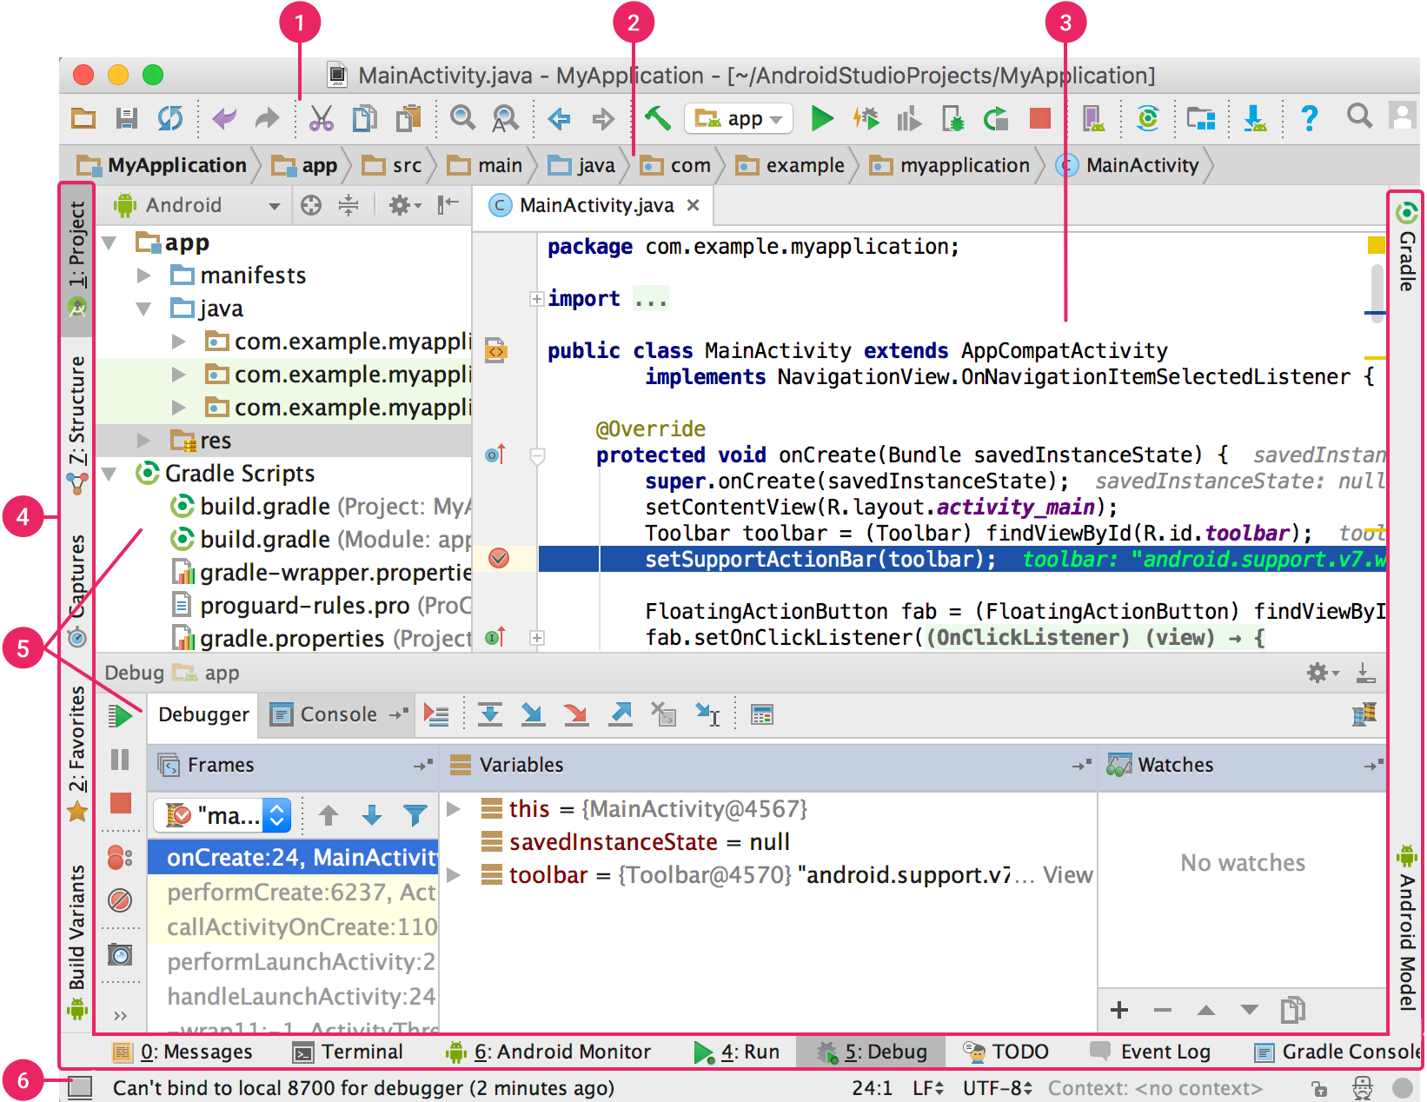
USER INTERFACE
The toolbar lets you carry out a wide range of actions, including running your app and launching Android tools.
The navigation bar helps you navigate through your project and open files for editing. It provides a more compact view of the structure visible in the Project window.
The editor window is where you create and modify code. Depending on the current file type, the editor can change. For example, when viewing a layout file, the editor displays the Layout Editor.
The tool window bar runs around the outside of the IDE window and contains the buttons that allow you to expand or collapse individual tool windows.
The tool windows give you access to specific tasks like project management, search, version control, and more. You can expand them and collapse them.
The status bar displays the status of your project and the IDE itself, as well as any warnings or messages.

Slide 11

Libraries and Frameworks used in Android Studio
Activities and Fragments for the UI part
Retrofit and Okhhtp for making Network calls
Room and SQLite database for storing data
Material Design
Gson converter for converting Json data to Kotlin code.
Piccasso and Glide
This Photo by Unknown Author is licensed under CC BY-ND

Slide 12
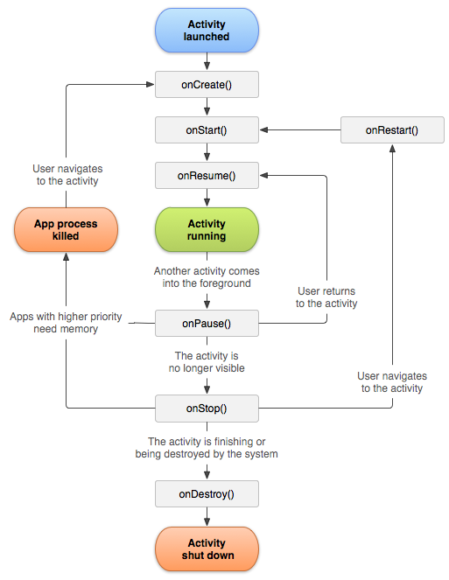
Activities and Fragments
The Activity class is a crucial component of an Android app,
and the way activities are launched and put together is a fundamental part of the platform's application model.
Unlike programming paradigms in which apps are launched with a main() method, the Android system initiates code in an Activity instance by
invoking specific callback methods that correspond to specific stages of its lifecycle.

Slide 13
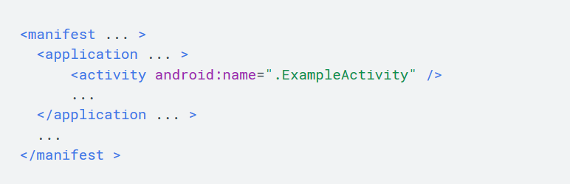
Declaring Activities
To declare your activity, open your manifest file and add an <activity> element as a child of the <application> element. For example:

Slide 14
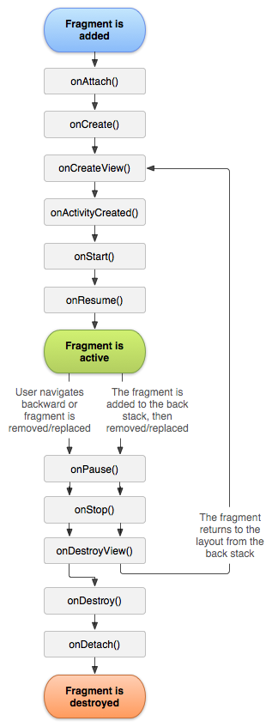
Fragments
A Fragment represents a behavior or a portion of user interface in a Fragment activity.
You can combine multiple fragments in a single activity to build a multi-pane UI and reuse a fragment in multiple activities.
You can think of a fragment as a modular section of an activity, which has its own lifecycle, receives its own input events,
and which you can add or remove while the activity is running (sort of like a "sub activity" that you can reuse in different activities).

Slide 15
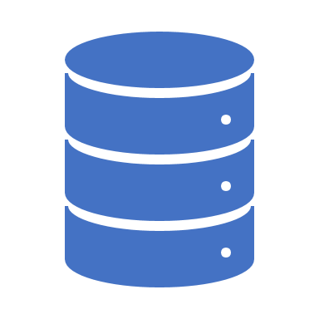
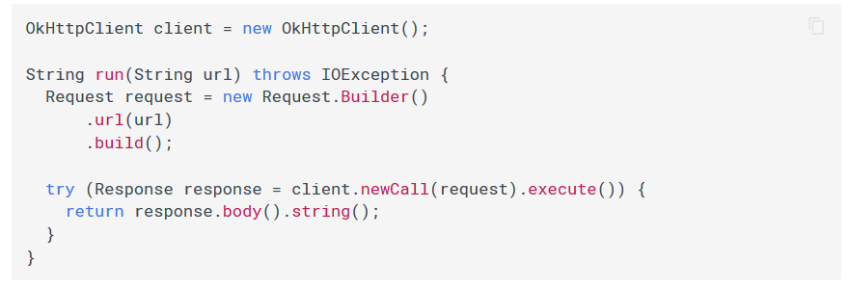
Retrofit and OKhttp
HTTP is the way modern applications network. It’s how we exchange data & media. Doing HTTP efficiently makes your stuff load faster and saves bandwidth.
OkHttp is an HTTP client that’s efficient by default:
HTTP/2 support allows all requests to the same host to share a socket.
Connection pooling reduces request latency (if HTTP/2 isn’t available).
Transparent GZIP shrinks download sizes.
Response caching avoids the network completely for repeat requests.

Slide 16
Retrofit
Retrofit is a REST Client library (Helper Library) used in Android and Java to create an HTTP request and also to process the HTTP response from a REST API. It was created by Square, you can also use retrofit to receive data structures other than JSON, for example SimpleXML and Jackson. Before we continue, let’s briefly define REST Client and REST API in our context.
REST Client in our case is the Retrofit library that is used on the client side (Android) to make HTTP request to REST API, in our case, The Movie DB API and process the response.
A REST API defines a set of functions which developers can perform requests and receive responses via HTTP protocol such as GET and POST. in our case, The Movie DB (TMDB) API is the REST API.
We can also simply say that a RESTful API is an application program interface (API) that uses HTTP requests to GET, PUT, POST and DELETE data.

Slide 17
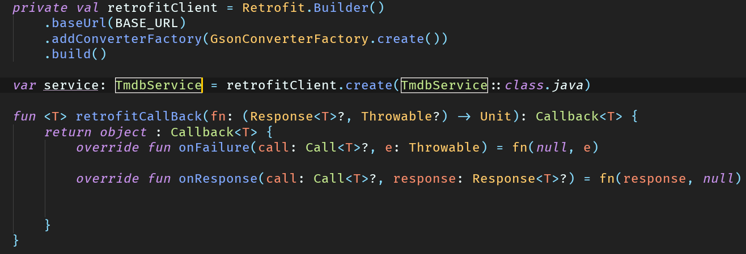
How to use?
To use Retrofit in your Android Application, you’ll need 3 major classes.
An Interface which defines the HTTP operations (Functions or methods)
According to Square, creators of Retrofit documentation, Retrofit turns your HTTP API into a Java interface. Sample codes for the interface and the method declared in it are as below:
Every method inside an interface represents one possible API call. It must have a HTTP annotation (GET, POST, etc.) to specify the request type and the relative URL. The return value wraps the response in a Call object with the type of the expected result.
Query parameters can also be added to a method.
A Retrofit class
The last of the 3 needed class is a simple POJO that matches each field in the JSON response object gotten from querying an API. It’s a simple class with getter and setter methods for each fields.

Slide 18
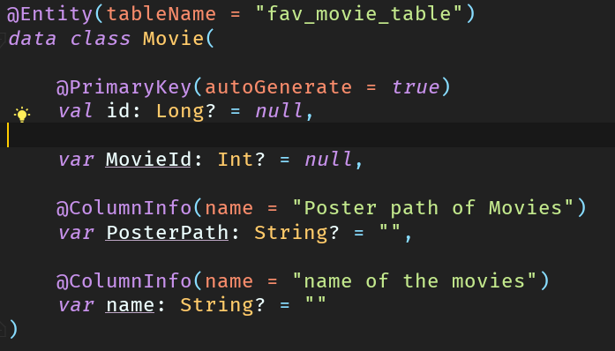
Room Persistence Library
The Room persistence library provides an abstraction layer over SQLite to allow for more robust database access while harnessing the full power of SQLite.
The library helps you create a cache of your app's data on a device that's running your app. This cache, which serves as your app's single source of truth, allows users to view a consistent copy of key information within your app, regardless of whether users have an internet connection.

Slide 19
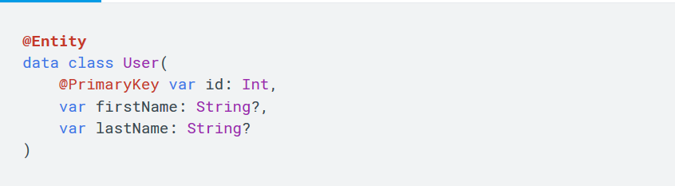
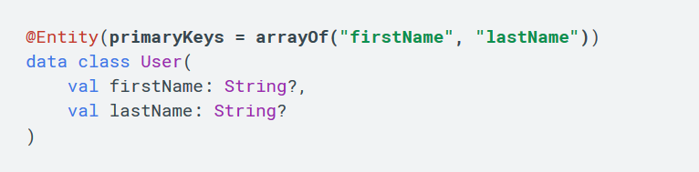
Defining data using Room entities
The following code snippet shows how to define an entity:
Use a primary key

Slide 20
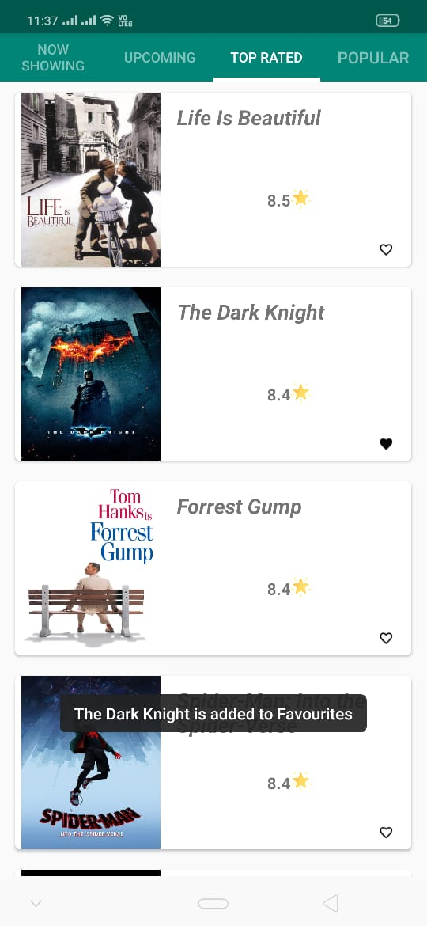
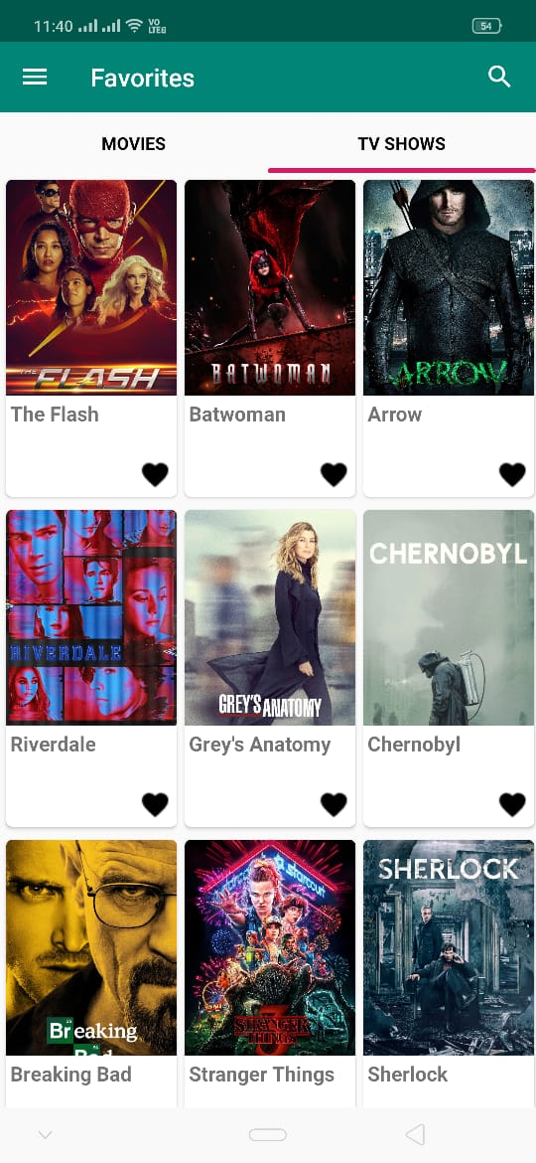
WHERE DID I USED ROOM ?

Slide 21
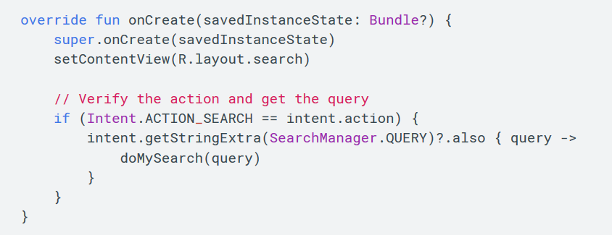
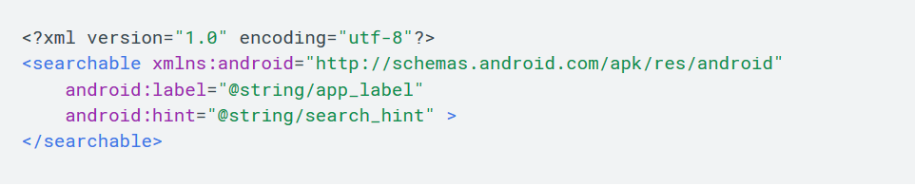
Search View
A widget that provides a user interface for the user to enter a search query and submit a request to a search provider. Shows a list of query suggestions or results, if available, and allows the user to pick a suggestion or result to launch into.
features available for the search dialog and widget include:
Voice search
Search suggestions based on recent queries
Search suggestions that match actual results in your application data

Slide 22
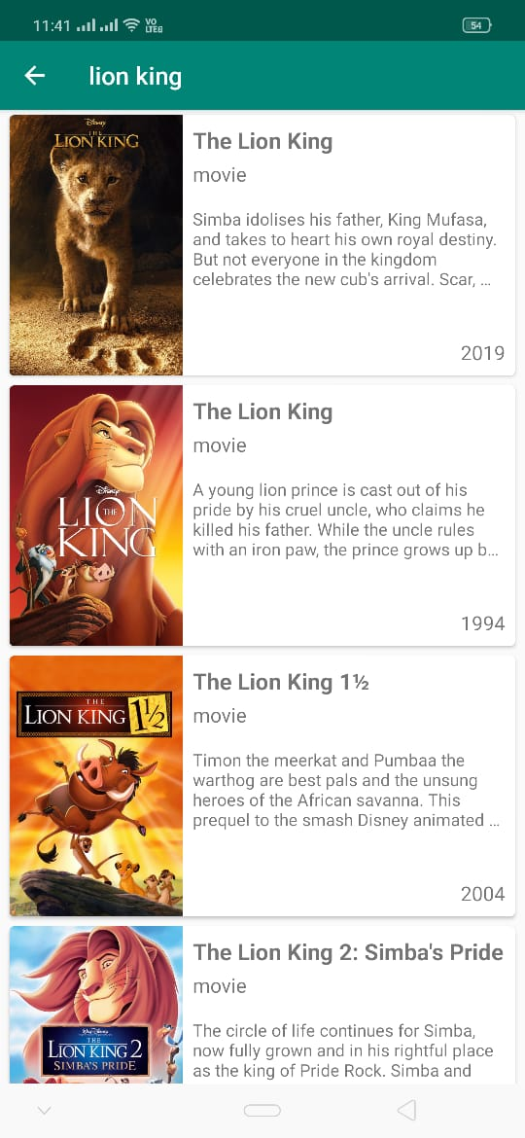
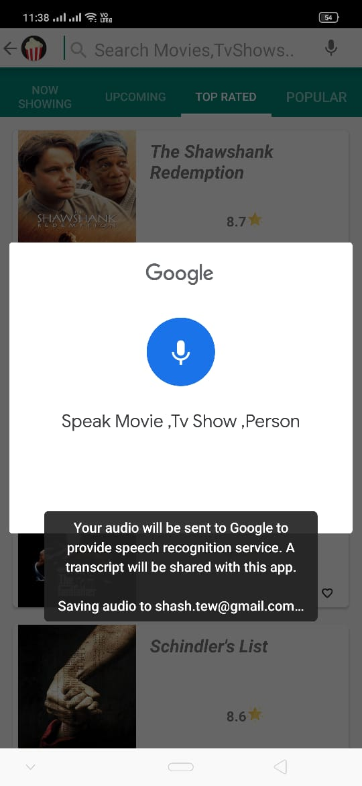
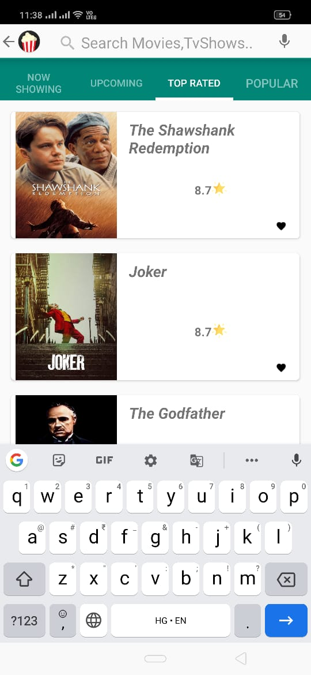
Search Anything ?

Slide 23
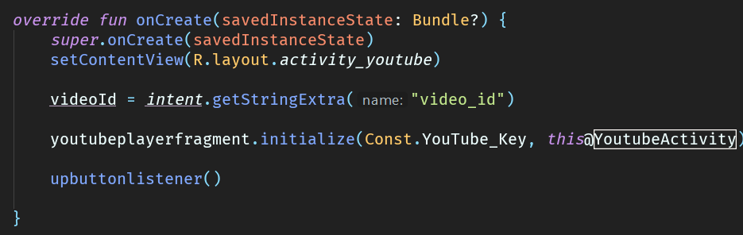
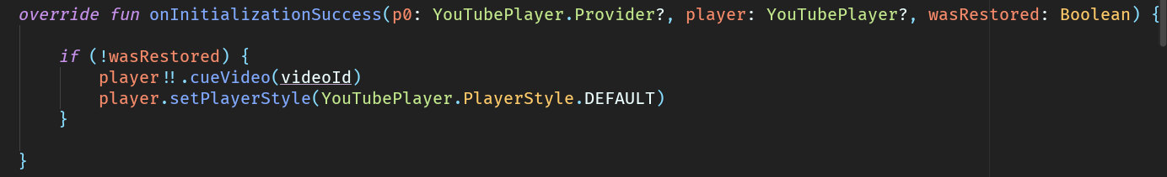
YouTube Android API
The YouTube Android Player API enables you to incorporate video playback functionality into your Android applications. The API defines methods for loading and playing YouTube videos (and playlists) and for customizing and controlling the video playback experience.
Using the API, you can load or cue videos into a player view embedded in your application's UI. You can then control playback programmatically. For example, you can play, pause, or seek to a specific point in the currently loaded video.
You can also register event listeners to get callbacks for certain events, such as the player loading a video or the player state changing. Finally, the API has helper functionality to support orientation changes as well as transitions to fullscreen playback.

Slide 24

Mini YouTube in the App ?

Slide 25
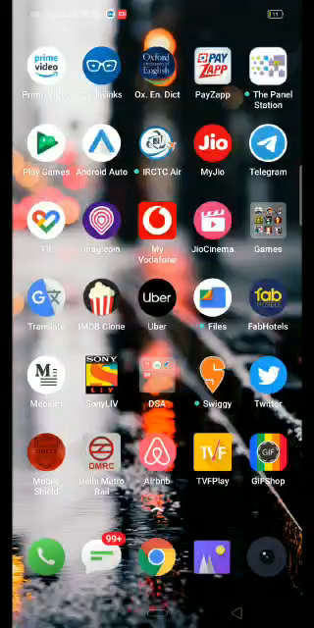
Need a Quick Demo?

Slide 26

Made by –Shashank Tewari

